Slide 1
AUTOMATED HYDROPONIC FARMING
REVIEW 1
LEAN START-UP MANAGEMENT

Slide 2
TEAM MEMBERS
Harsh Vardhan Singh (18BME0030)
Lakshya Mishra (18BME0096)
Shashank Shukla (18BCE2522)

Slide 3
INTRODUCTION
It is based on the concept of Hydroponic Farming.
Hydroponic farming is a method of farming in which plants are grown without soil, by using mineral nutrient solutions in a water solvent.
The farms can be used for growing plants and crops such as lettuce, spinach, tomato, strawberry ,broccoli and also some flowering species.
Process of Hydroponic farming is more water efficient, promotes the rapid growth of plants and also does not make use of any chemical fertilizers or pesticides.

Slide 4
PROBLEMS SERVING
To cater the need of growing food requirements of the country’s growing population.
To increase the food production with the shrinking area of cultivable land.
To reduce the food shortage of the urban areas espeially in case of pandemics.
To reduce the food wastage due to the logistics of vegetables and fruits in the areas where there is no land for growing food.
To grow food and organic vegetables in those areas which face a huge shortage of water in some seasons.( for e.g: Chennai, Delhi, Mumbai and Bangalore)
The national average for vegetable yields in India is 17 tons/ha; in developed countries it is more than 40 tons/ha due to infertility of soil, bad climatic conditions and less use of new technology.

Slide 5
SOLUTION
Hydroponics yield is twice or thrice as compared to conventional soil farming (ref: Hydroponic food production by Dr Howard Rash)
In hydroponics there is less than half the land required as compared to the conventional soil farming.( In a paper named as Economic viability of hydroponics system in emerging countries by Souja ,Gimnes and Binetto)
This method is best suited for the less cultivable areas where there is a large shortage of water or land and in arid regions.
This hydroponic pod can be installed at the rooftop of homes and restaurants and will help in the self sustainability of food.

Slide 6
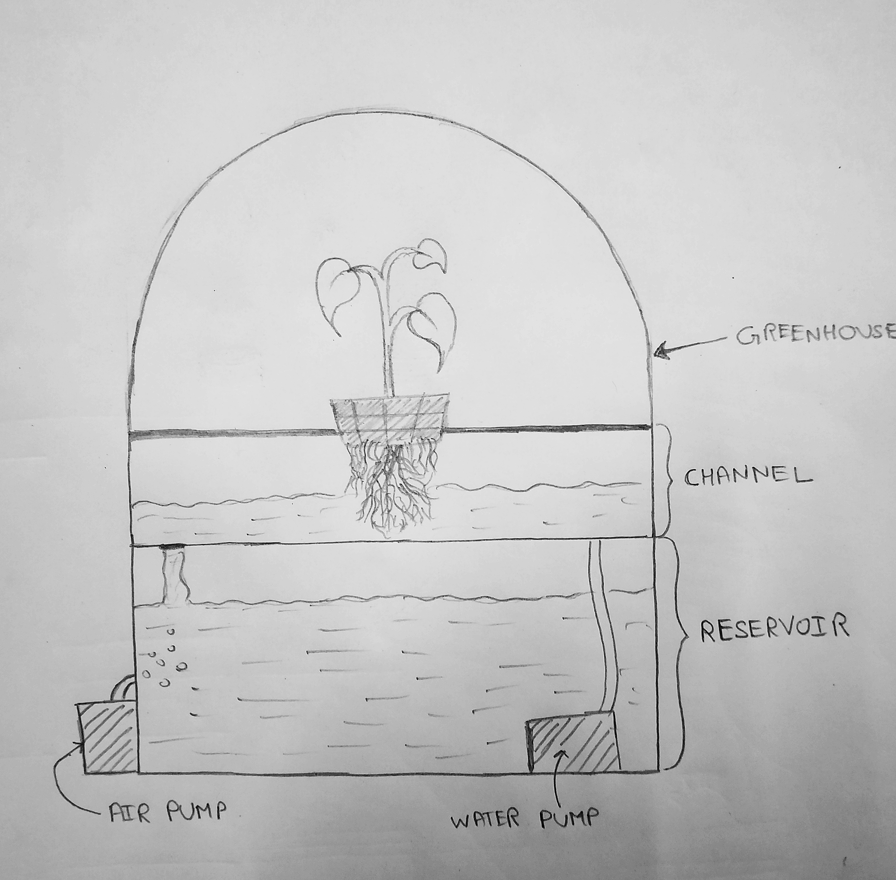
AUTOMATED HYDROPONIC POD- Basic Layout
It consists of three areas –
The Reservoir
The Channel
The Greenhouse

Slide 7
WORKING
The Reservoir stores the water that is nutrient rich and properly oxygenated. The water from the reservoir goes to the channel and returns back after each circulation.
The Channel contains the plant roots which are provided with nutrition via the thin film of solution that flows over them. (NFT – Nutrient Film Technique)
The Greenhouse contains the plant stock. It protects it from the outer elements and helps in controlling the inner conditions to better suit the plant.

Slide 8
BUSINESS PLAN
Acquire farms which are left after burning or where soil is infertile and are not being used, on lease.
Setup the hydroponic farm on the acquired land.
Extend the lease after showing acquired profits.
Acquire permission to use the terrace of commercial buildings in urban areas.
A hydroponic farm can be setup on the terraces and the grown crops can be supplied to the local consumers or businesses.
Home growers can use hydroponic pods for growing edible plants or for growing flowers for decoration purposes.

Slide 9
PROFIT !
Operational costs, with tomatoes as the example crop, in 1 acre per year are Rs 9 lakhs and revenue typically averages around 33.5 lakhs.
When the land is already owned, capital costs per acre every 5 years are Rs 30.5 lakhs.
If land is leased, profit averages around 16.5 lakhs per year.
With normal soil farming, farmer has a profit of around 1.20 lakh from 1 acre of tomato cultivation on an average for 4 months.

Slide 10
TIMELINE
Review 1 – (Prototype drawing and Idea explanation)
Review 2 – (Detailed analysis of idea)
Review 3 – (Final report with all required details)

Slide 11
REFERENCES
Hydroponic food production by Dr Howard Rash
Economic viability of hydroponics system in emerging countries (Souja ,Gimnes and Binetto April 2019)
Tomato profit per year, by Agri Farming
Why adoption of Hydroponic farming important in India, by Re-Nubble.

